Slide 1

CAMPUS
EATS
VIRGINIA STATE UNIVERSITY

Slide 2
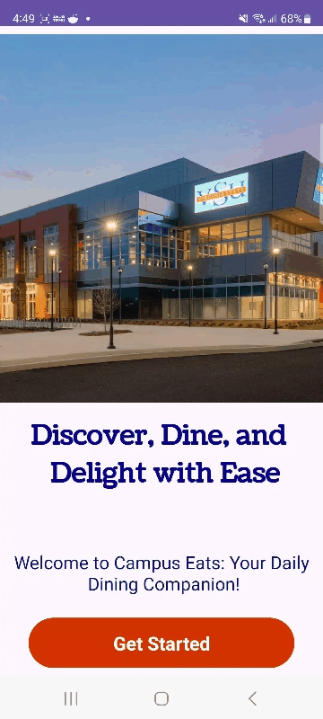


WHAT IS CAMPUS EATS?
Campus Eats is a mobile app which allows users to check the meals of the day at the Virginia State University dining halls. We used Firebase as our real-time database.

Slide 3
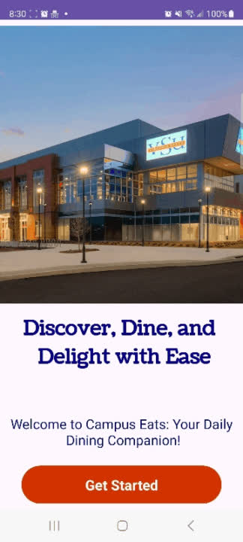
Main Features
Users can log in
Users can create reviews for the dining halls
Users can go to the Gateway, Jones and Locations tab

Slide 4
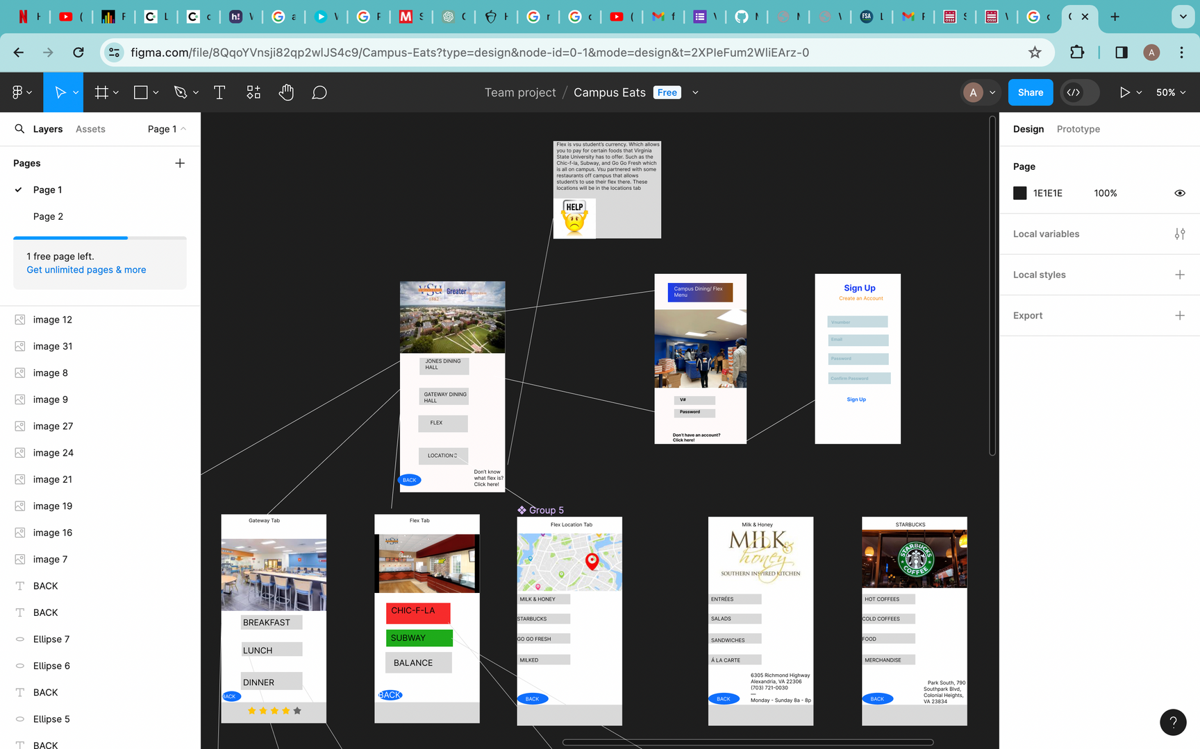
WIREFRAME

Slide 5
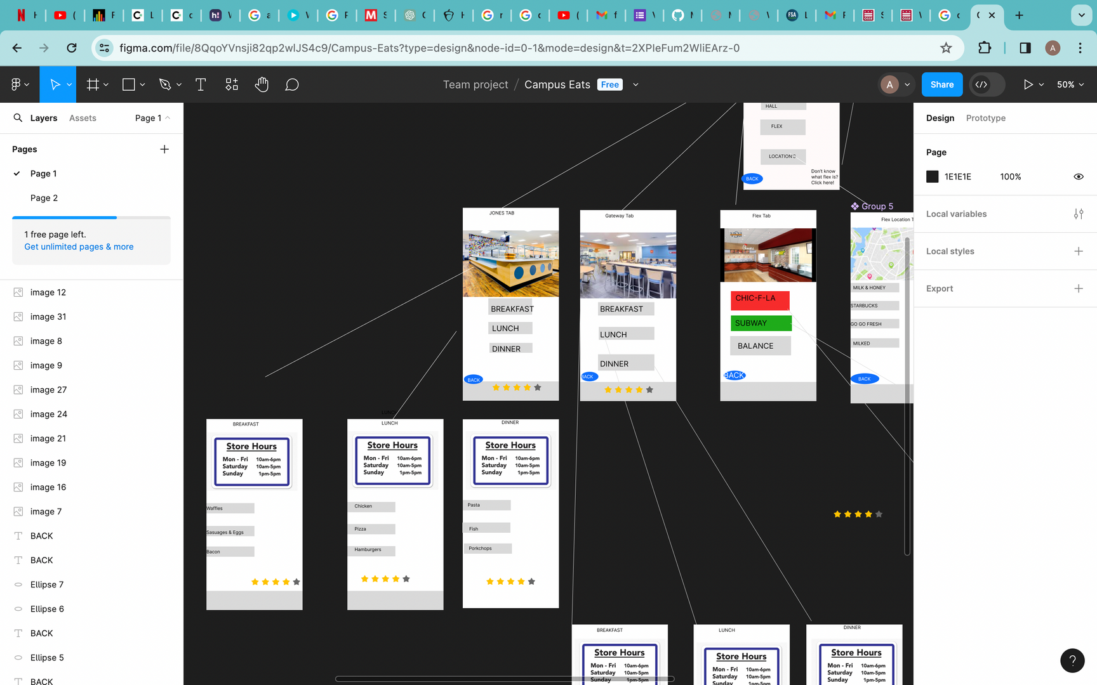
WIREFRAME

Slide 6
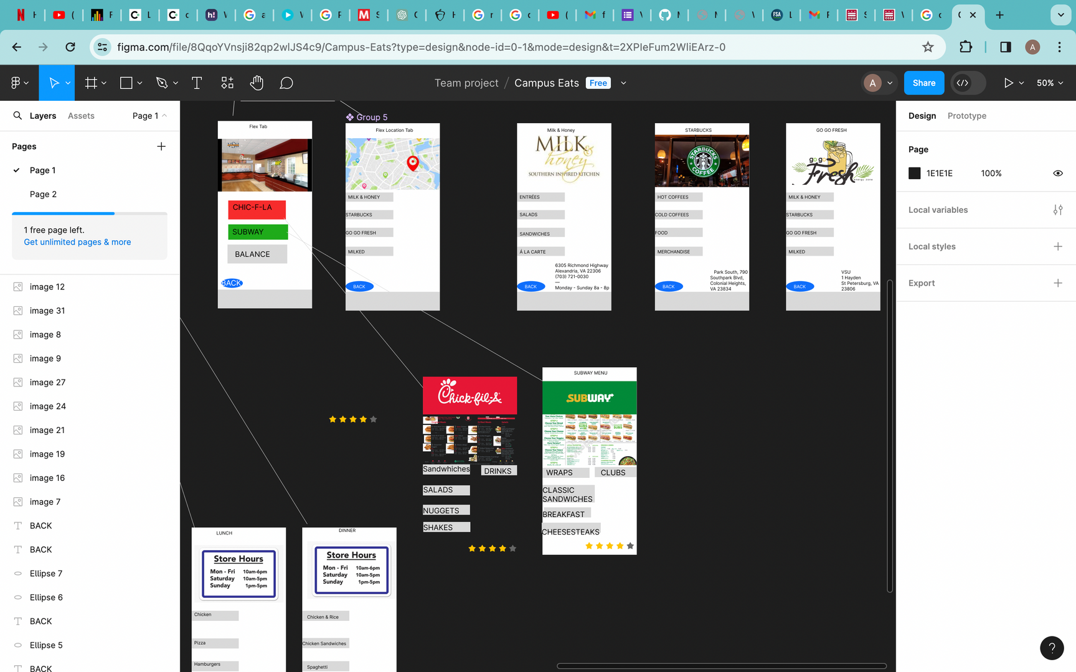
WIREFRAME

Slide 7
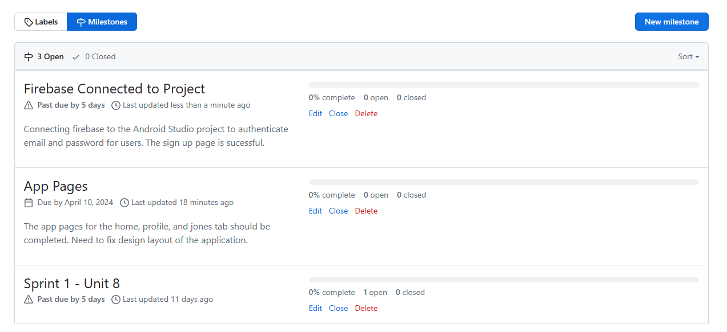
MILESTONES

Slide 8
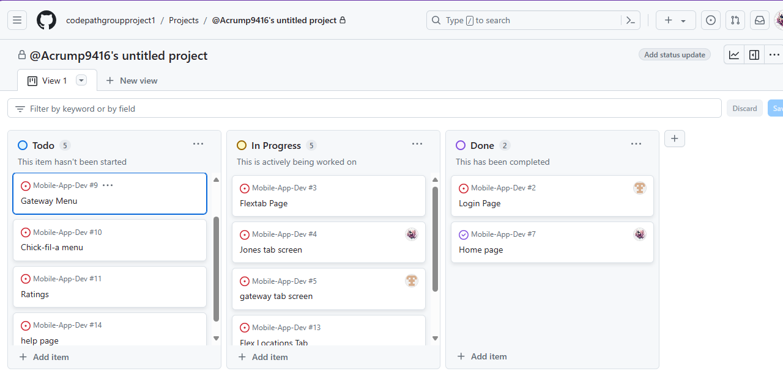
ISSUES

Slide 9
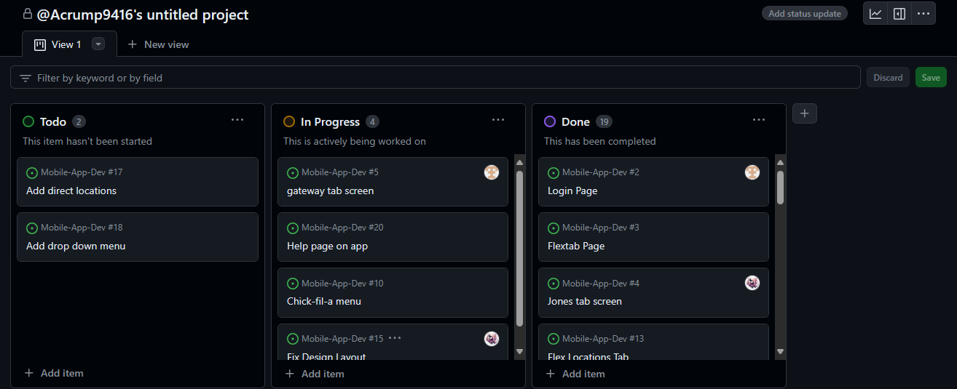
ISSUES

Slide 10
Feature Implications
Google map with locations
Real-time reviews using Firebase
Better Design Layout
Implement the Help Page

Slide 11


